Slide 1
Overview
Improvements in vDSO calls
Multi-page annotations
Parallel Sort
Baseline performance
Concurrency overhead
Page fault profile
Adding annotations

Slide 2
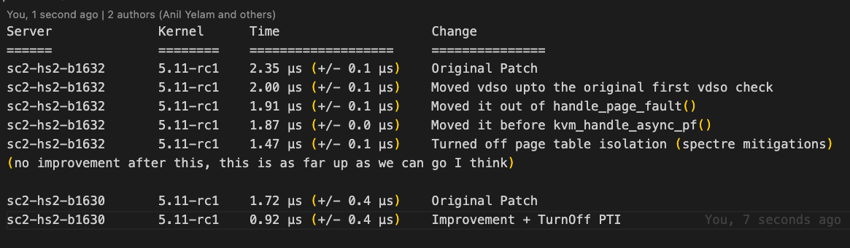
vDSO Improvements
Moved return closer to the start of the exception handler
Turned off PTI

Slide 3
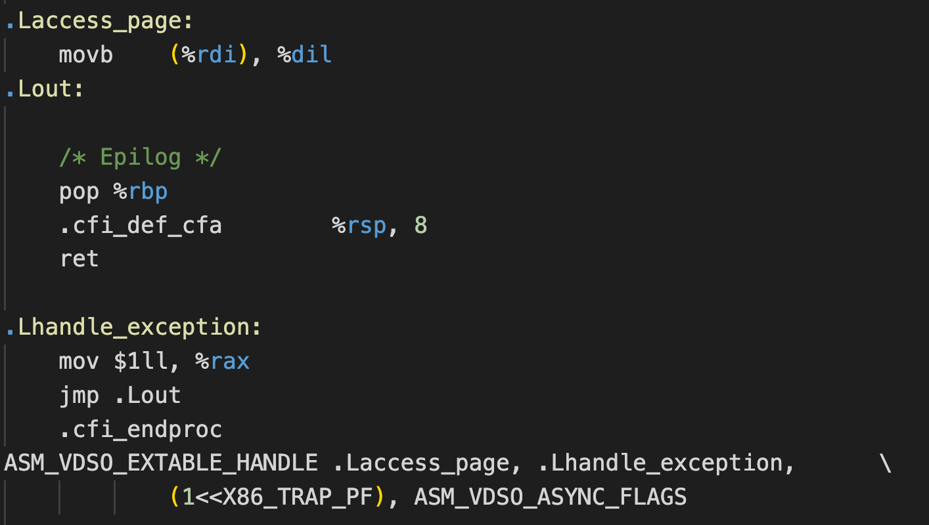
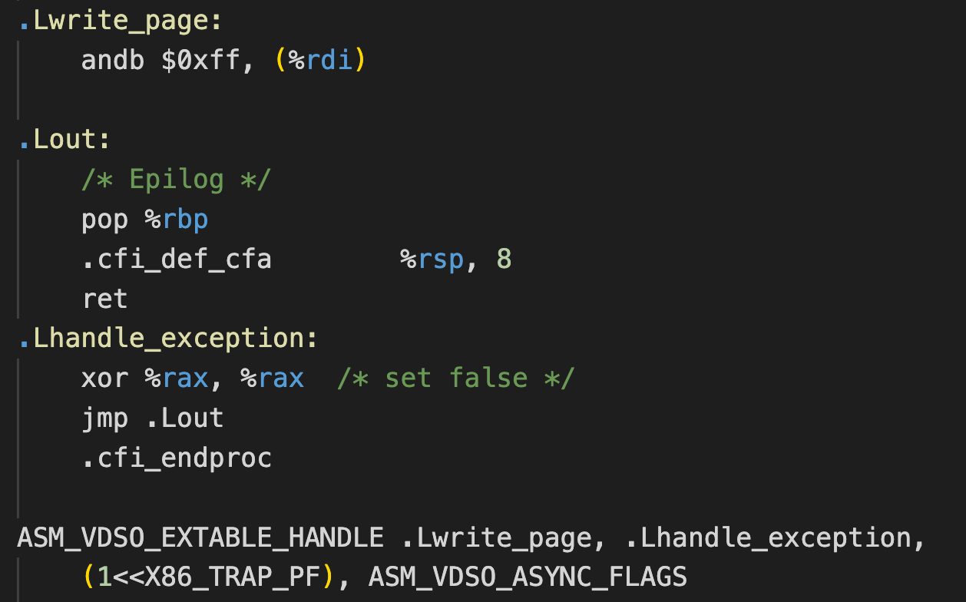
vDSO Improvements
Simplified calls
New check for write-protect
Page mapped check
Page write-protected check
Notes:
TODO: try a 64-bit op instead of byte-ops
TODO: more research on the correctness of andb (double-check) TSO memory model

Slide 4
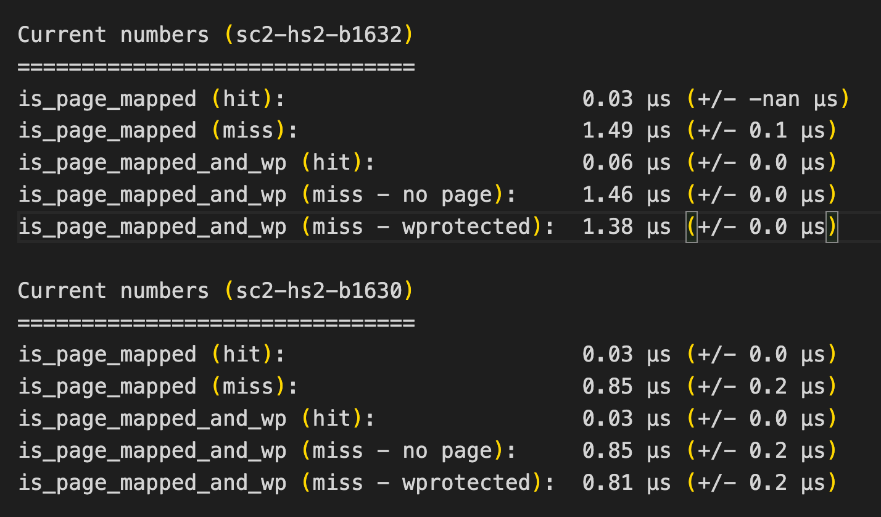
vDSO Improvements

Slide 5
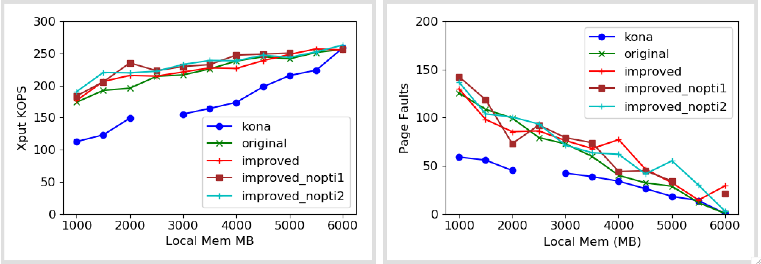
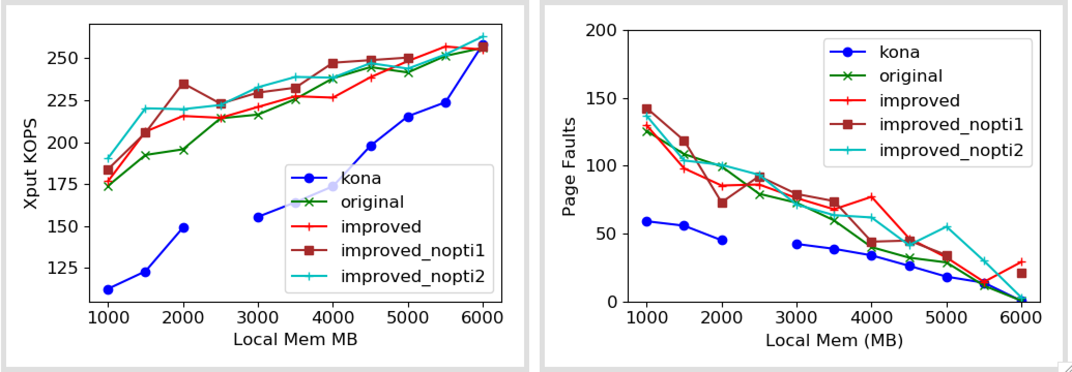
vDSO Improvements
Effect on Synthetic App Performance
Notes:
See some gain on the left most, where page faults are high enough?
Get more runs to establish average gain?
Look into the variance?

Slide 6
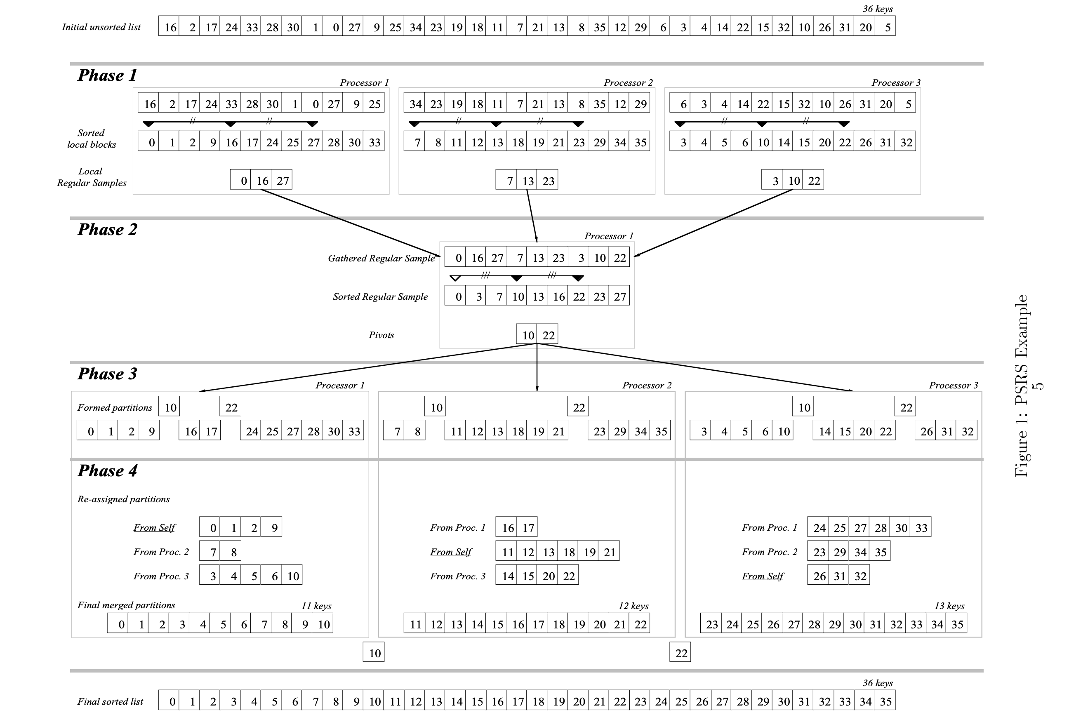
Sort
Parallel sort with regular sampling (PSRS)

Slide 7
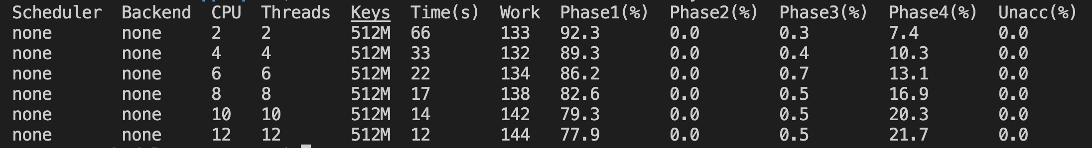
Baseline Performance/Scalability

Slide 8
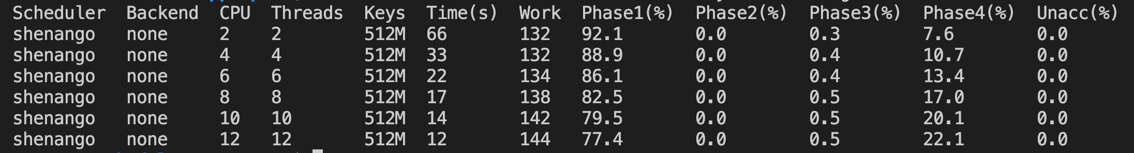
Works with Shenango Threads
Notes:
No difference, at least yet

Slide 9
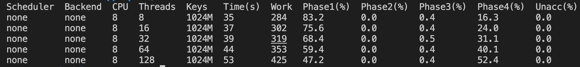
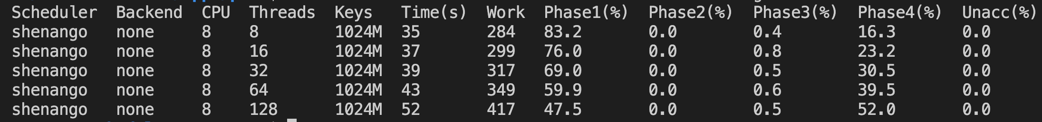
Concurrency overhead
Notes:
Overhead in the last phase – because of the thread factor. None of the thread “overheads” seem to matter at this point.
Overhead might not be this pure in a skewed case
We might be opening a trade-off between overhead introduced by concurrency and benefits of page faults enabled by it

Slide 10
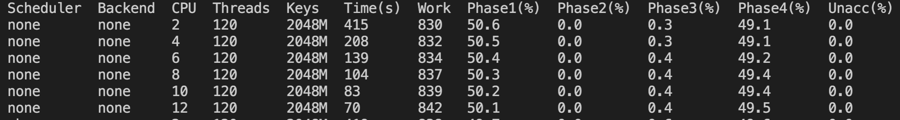
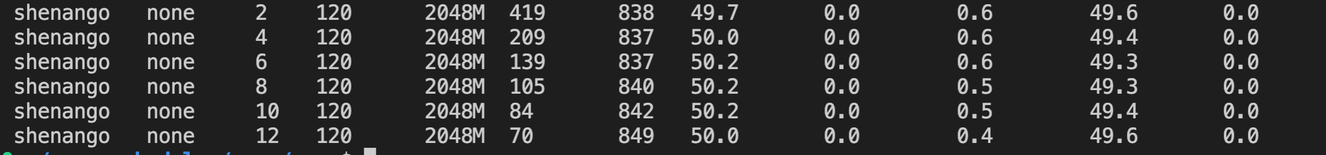
Concurrency overhead
Notes:
Overhead in the last phase – because of the thread factor. None of the thread “overheads” seem to matter at this point.
Overhead might not be this pure in a skewed case
We might be opening a trade-off between overhead introduced by concurrency and benefits of page faults enabled by it

Slide 11
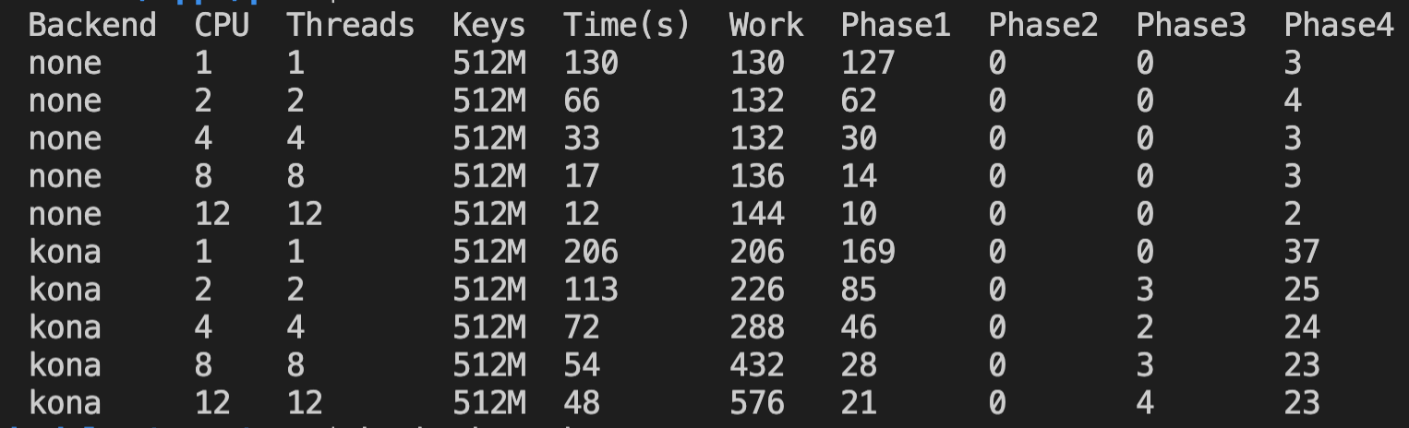
Performance with Kona
512M keys ~ 2GB
1GB Local
Notes:
Total work increased
Higher phase 1 overall but scales alright (good locality?)
Compute-intensity higher
Phase 4 blew up by an order of maginitude:
poor locality? More cores help but only to an extent?
But also because of the higher working set now?
Because copy-back should have enough locality
Don’t understand why copyback doesn’t decrease…

Slide 12
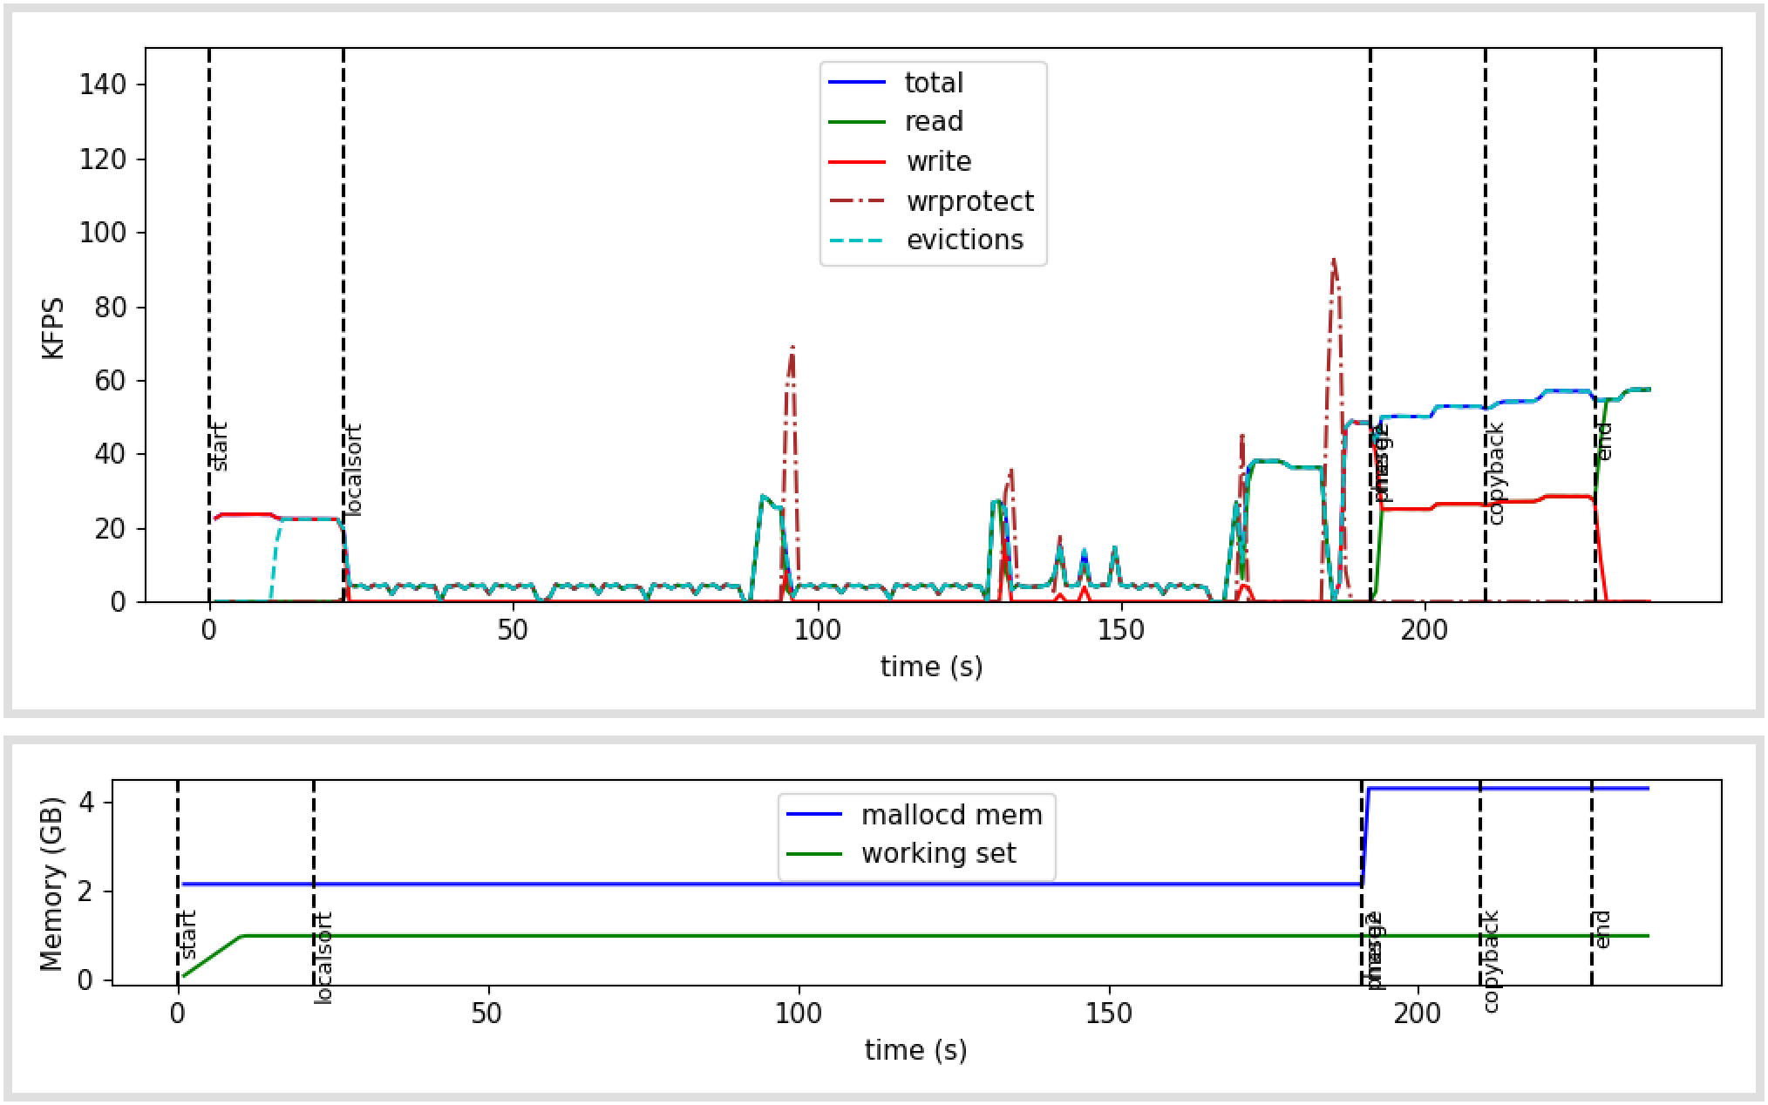
Sort Fault Profile
1 core
512M keys ~ 2GB
1GB Local
Notes:
Write-protects in local sorting phase – avoidable
Do the

Slide 13
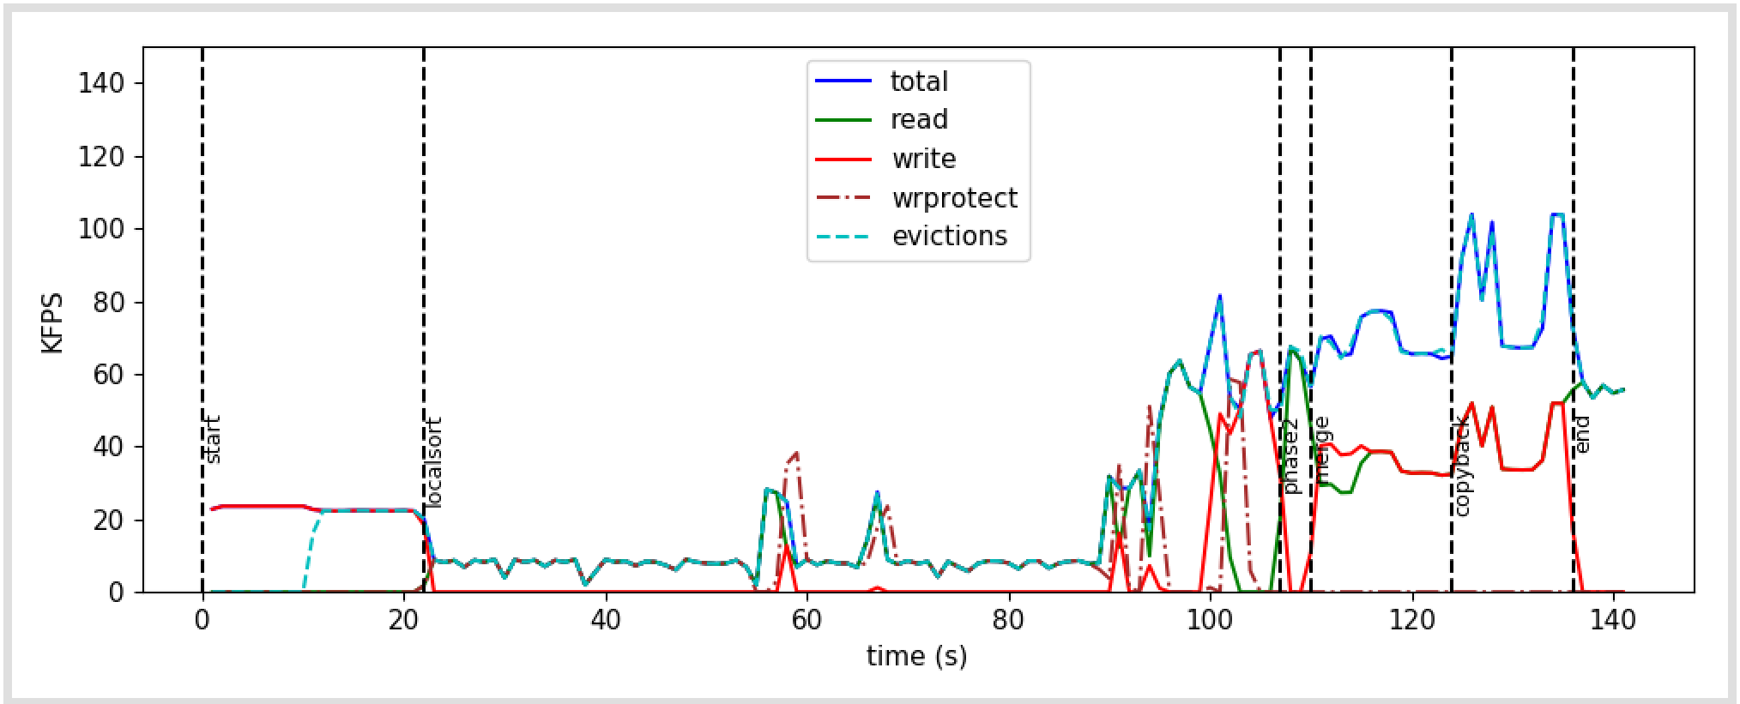
Sort Fault Profile
2 cores
512M keys ~ 2GB
1GB Local
Notes:
Write-protects in local sorting phase – avoidable
Do the

Slide 14
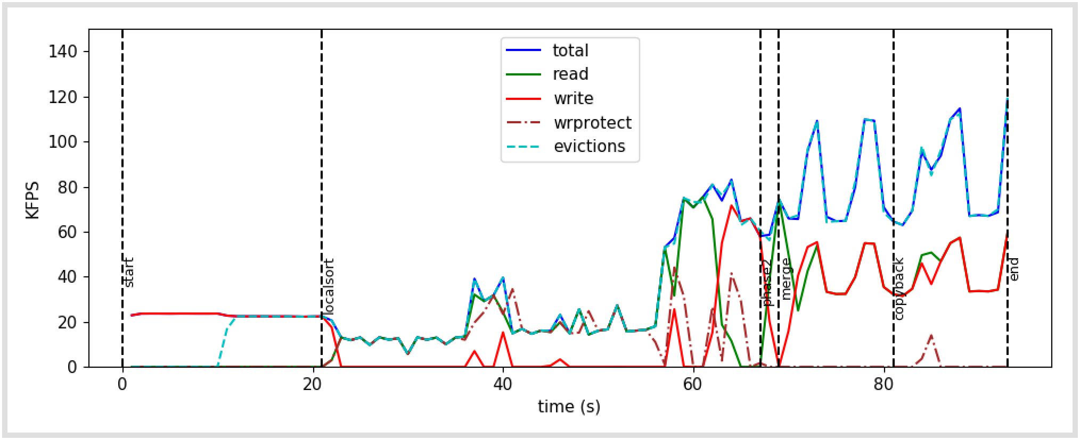
Sort Fault Profile
4 cores
512M keys ~ 2GB
1GB Local

Slide 15
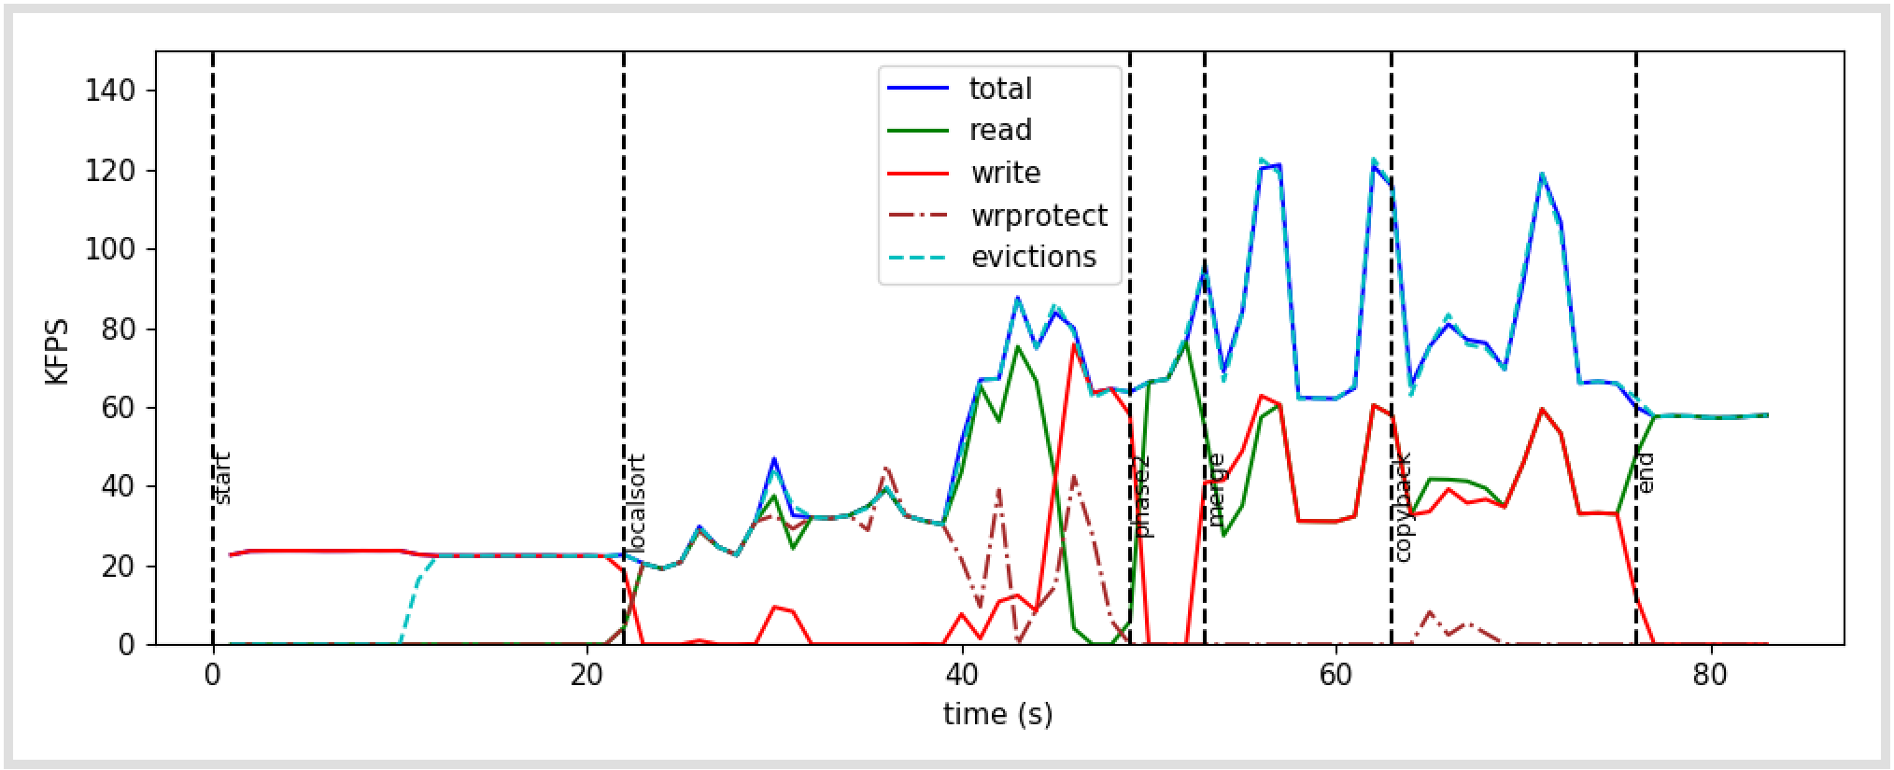
Sort Fault Profile
8 cores
512M keys ~ 2GB
1GB Local

Slide 16
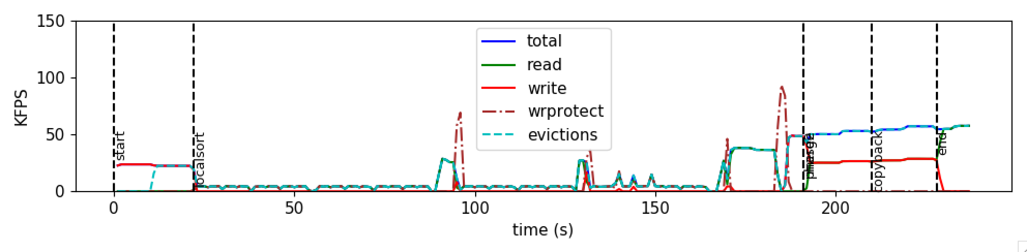
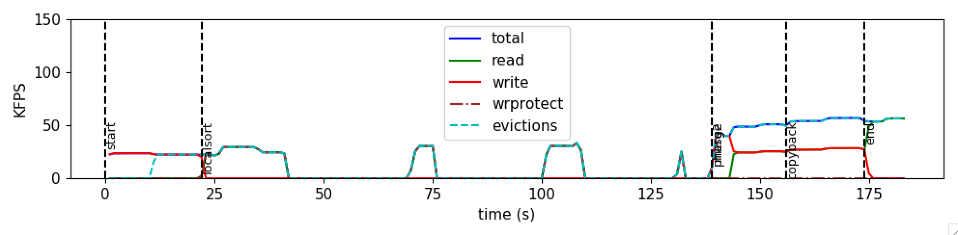
Sort Fault Profile (Custom QSort)
1 core
512M keys ~ 2GB
1GB Local

Slide 17
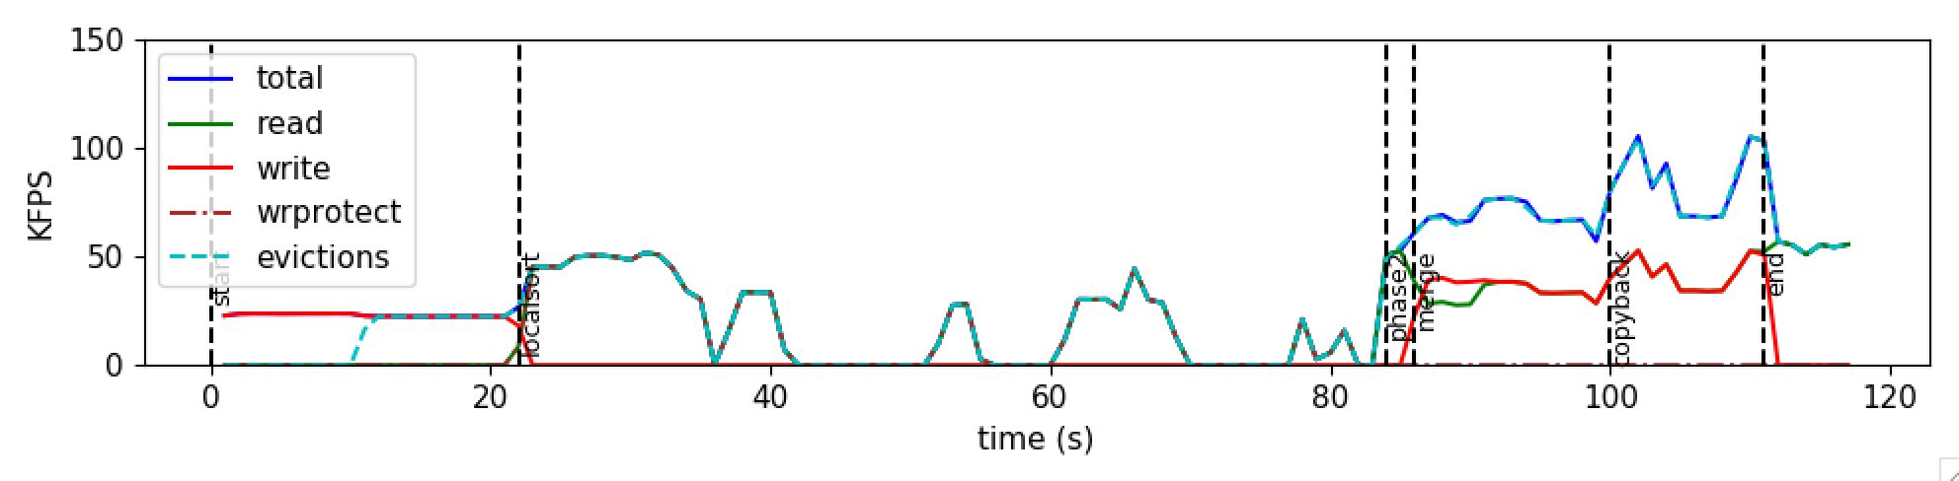
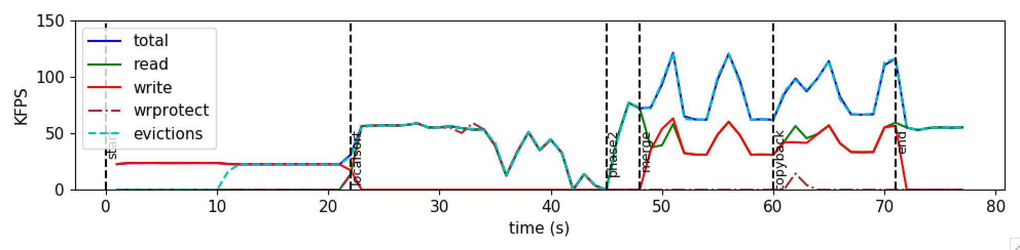
Custom QSort
1/2/4 cores
512M keys ~ 2GB
1GB Local

Slide 18
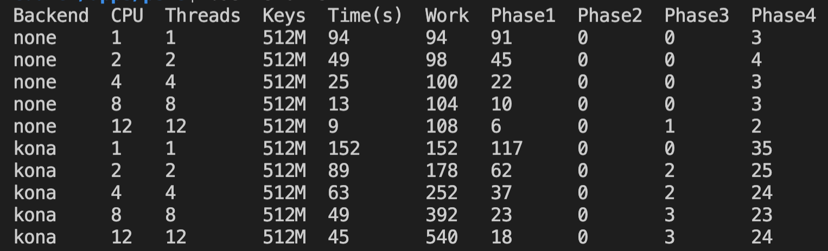
QSort: Custom vs Stdlib
1 core
512M keys ~ 2GB
1GB Local
Notes:
Custom Qsort is faster!
But other trends hold

Slide 19
Next
Sort
Why does merge/copyback scale badly?
Annotations
Feedback: Build a tool for finding faulting locations

Slide 20
Finding fault Locations
(Kernel) Included IP register in the UFFD messages
Turn off PIE/ASLR
addr2line prints out code location!
Added random fault sampling in Kona

Slide 21
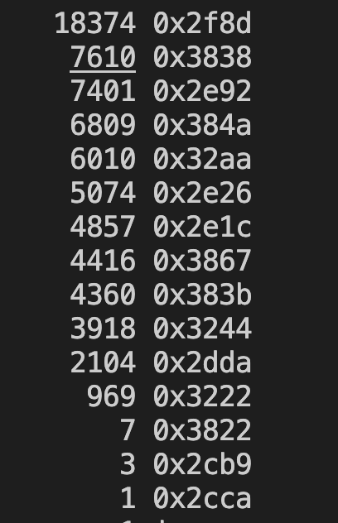
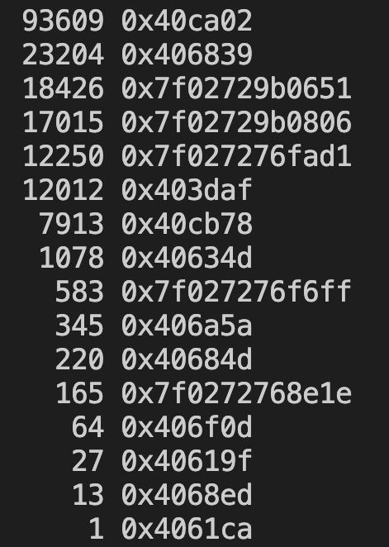
Fault Location Frequency
Sort
Synthetic
Memcached

Slide 22
Misc

Slide 23
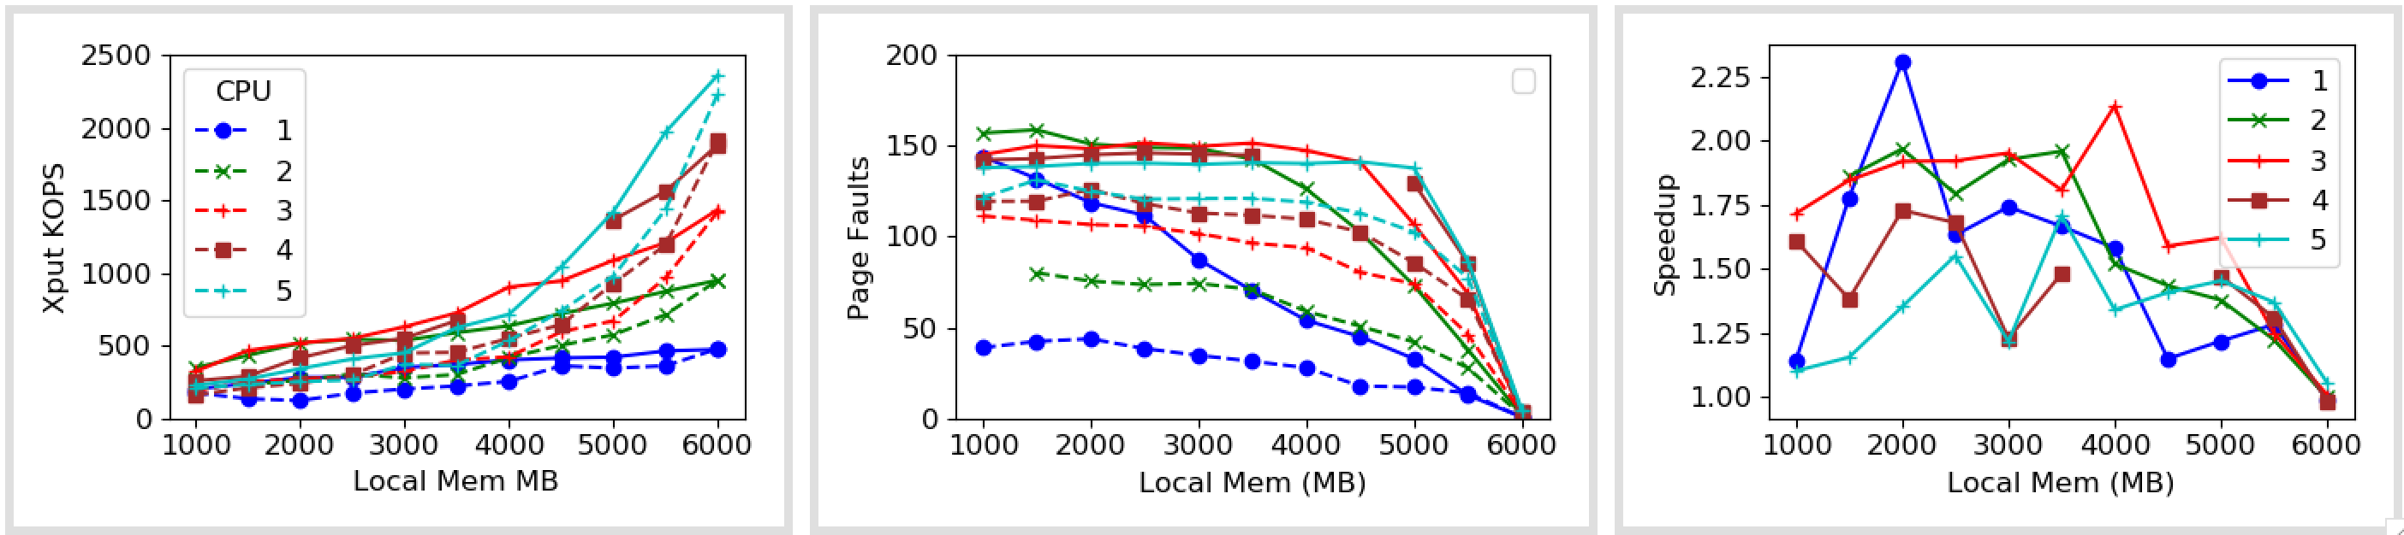
1x Zip

Slide 24
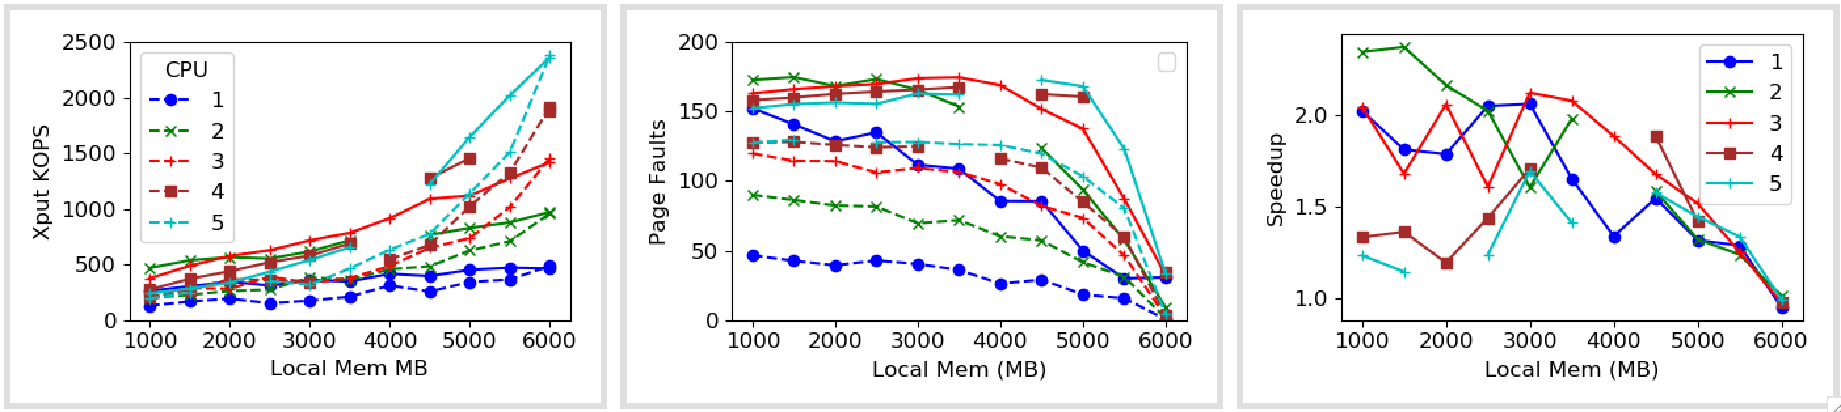
1x Zip (vDSO)

Slide 25
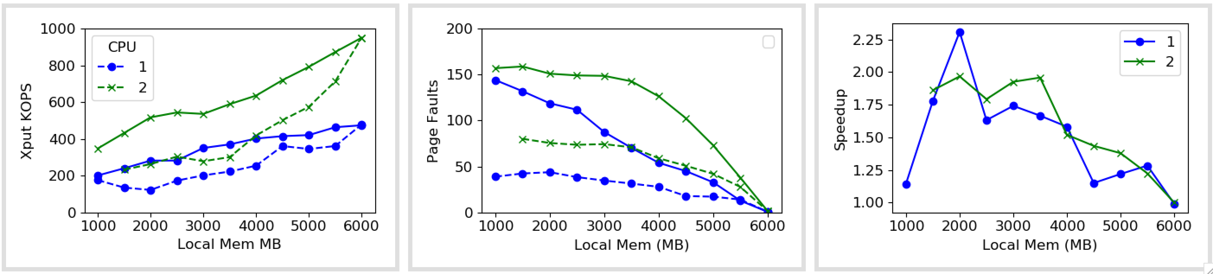
1x Zip

Slide 26
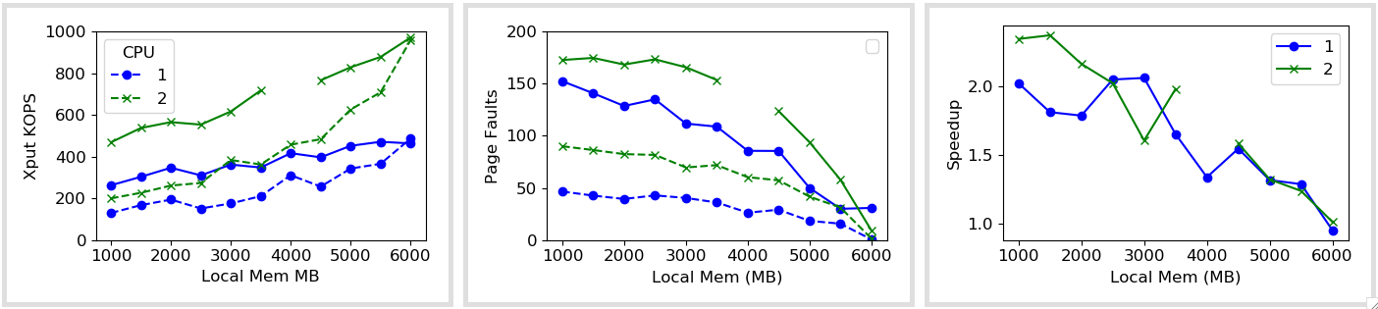
1x Zip (vDSO)

Slide 27
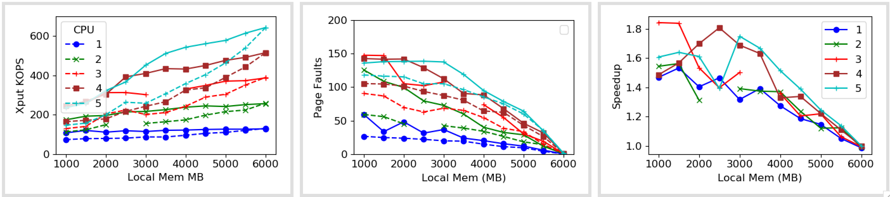
5x Zip

Slide 28
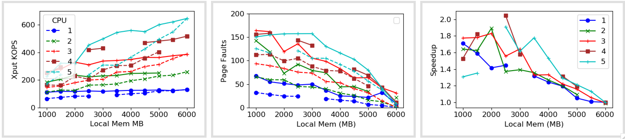
5x Zip (vDSO)

Slide 29
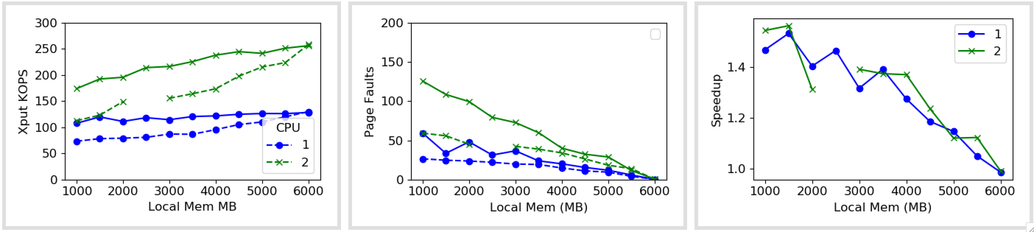
5x Zip

Slide 30
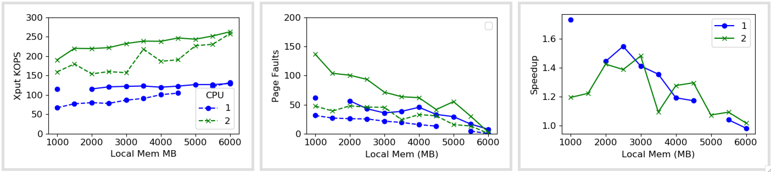
5x Zip (vDSO)

